Slide 1



hpl final
View in Power BI
Last data refresh:
7/6/2023 5:58:35 AM UTC
Downloaded at:
10/12/2023 7:22:03 AM UTC

Slide 2
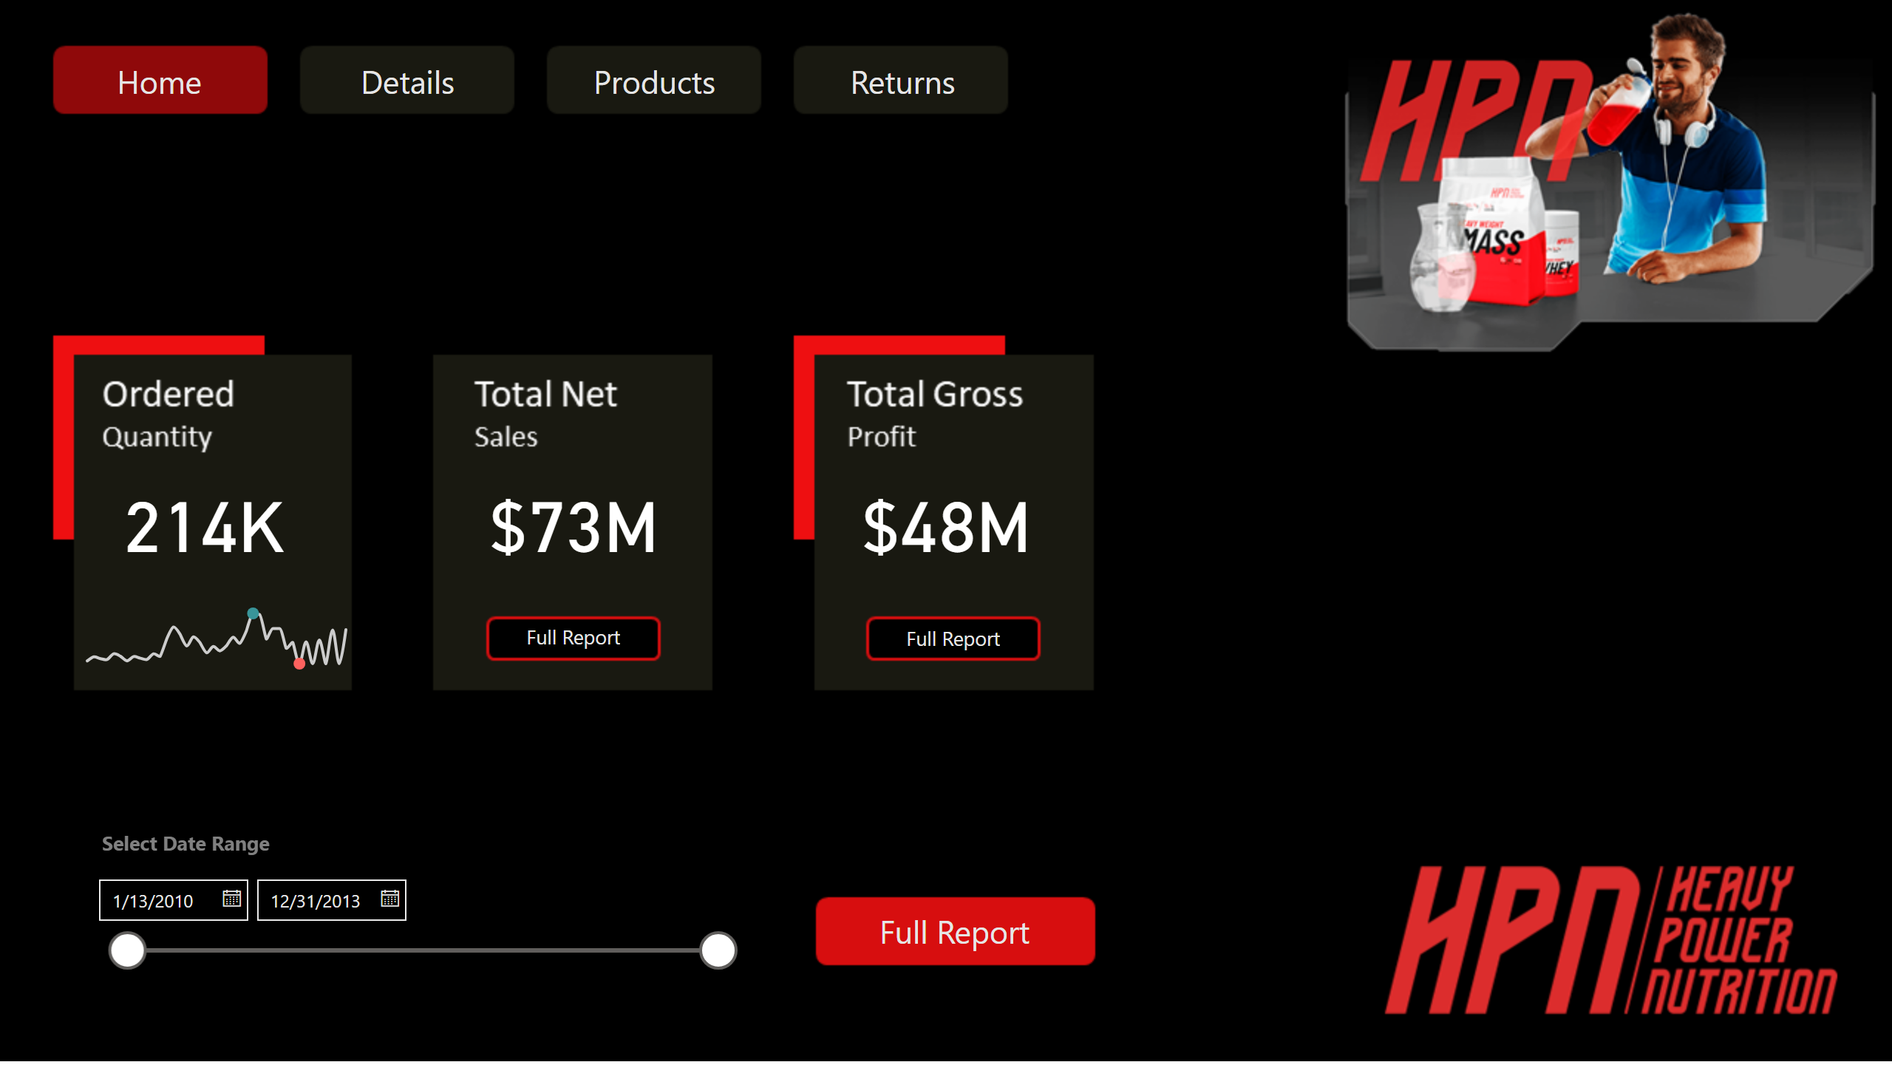
Home
Notes:
card
No alt text provided
PBI_CV_25997FEB_F466_44FA_B562_AC4063283C4C
No alt text provided
card
No alt text provided
card
No alt text provided
slicer
No alt text provided
textbox
No alt text provided
actionButton
No alt text provided
actionButton
No alt text provided
actionButton
No alt text provided
actionButton
No alt text provided
actionButton
No alt text provided
actionButton
No alt text provided
actionButton
No alt text provided

Slide 3
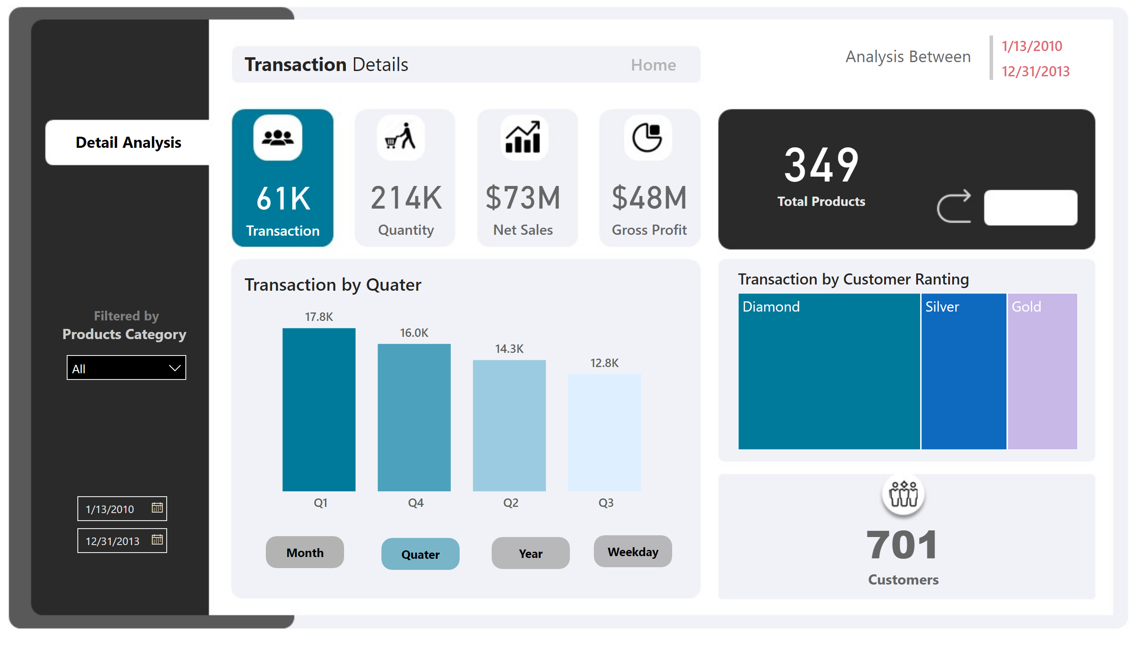
Transaction
Notes:
transectionCard
No alt text provided
qauatityCard
No alt text provided
saleCard
No alt text provided
profitCard
No alt text provided
ProductCard
No alt text provided
lineChart
No alt text provided
columnChart
No alt text provided
Transaction by Quater
No alt text provided
columnChart
No alt text provided
actionButton
No alt text provided
InactiveMonth
No alt text provided
actionButton
No alt text provided
InactiveWeekday
No alt text provided
actionButton
No alt text provided
InactiveYear
No alt text provided
actionButton
No alt text provided
ActiveQuater
No alt text provided
Transaction by Customer Ranting
No alt text provided
ProductCard
No alt text provided
textbox
No alt text provided
InactiveQuater
No alt text provided
slicer
No alt text provided
actionButton
No alt text provided
textbox
No alt text provided
multiRowCard
No alt text provided
textbox
No alt text provided
slicer
No alt text provided

Slide 4
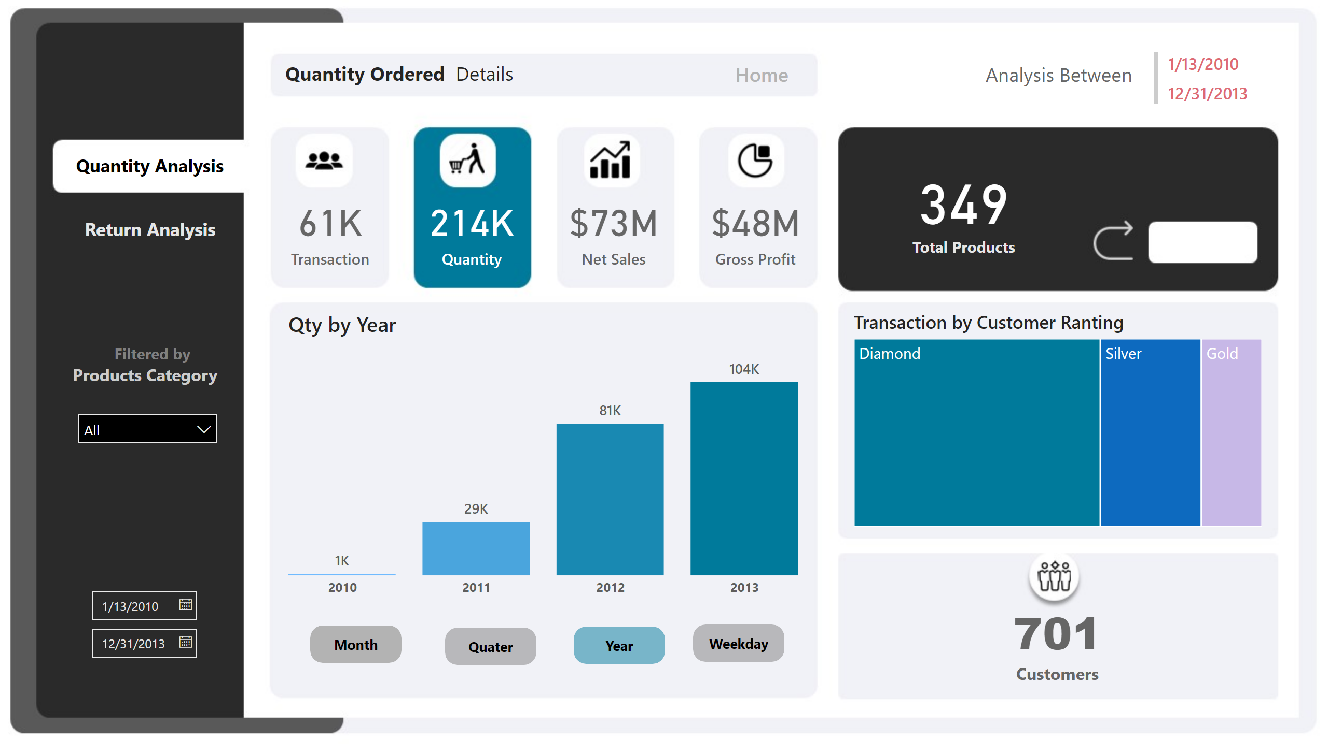
Qty Ordered
Notes:
transectionCard
No alt text provided
qauatityCard
No alt text provided
saleCard
No alt text provided
profitCard
No alt text provided
ProductCard
No alt text provided
lineChart
No alt text provided
columnChart
No alt text provided
columnChart
No alt text provided
Qty by Year
No alt text provided
actionButton
No alt text provided
InactiveMonth
No alt text provided
actionButton
No alt text provided
InactiveWeekday
No alt text provided
ActiveYear
No alt text provided
actionButton
No alt text provided
InactiveQuater
No alt text provided
actionButton
No alt text provided
Transaction by Customer Ranting
No alt text provided
ProductCard
No alt text provided
textbox
No alt text provided
InactiveQuater
No alt text provided
slicer
No alt text provided
actionButton
No alt text provided
InactiveQuater
No alt text provided
textbox
No alt text provided
multiRowCard
No alt text provided
textbox
No alt text provided
slicer
No alt text provided

Slide 5
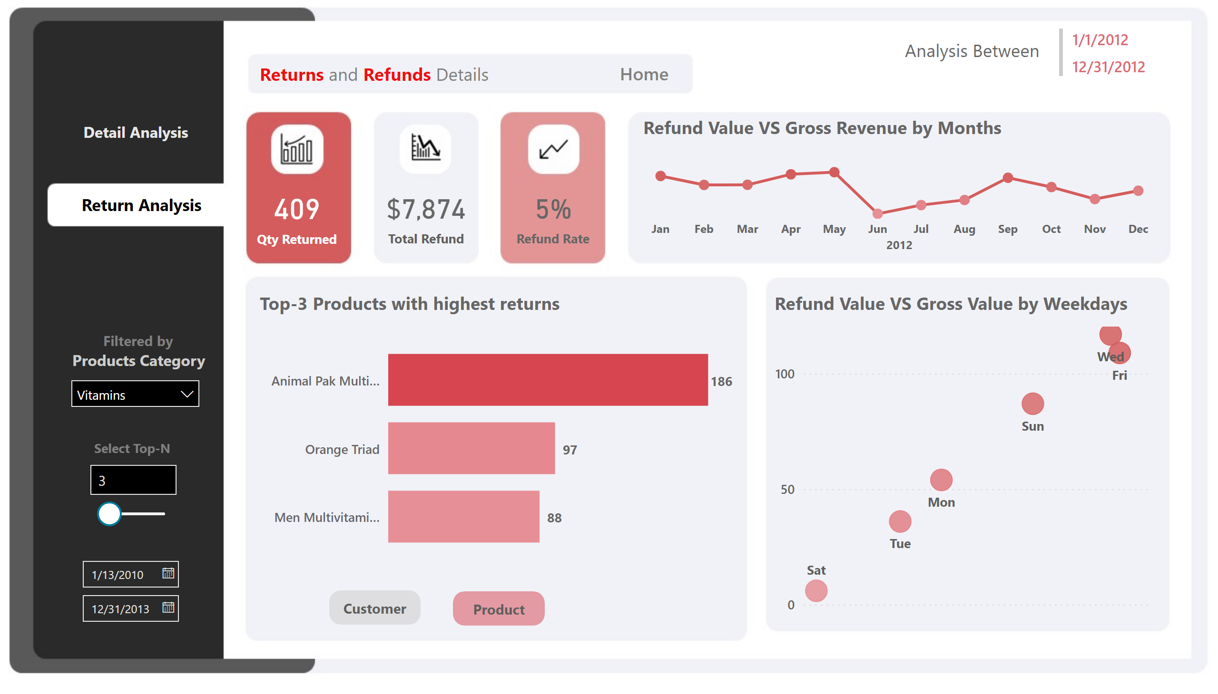
Return
Notes:
barChart
No alt text provided
Top-3 Products with highest returns
No alt text provided
slicer
No alt text provided
CinActive
No alt text provided
actionButton
No alt text provided
actionButton
No alt text provided
PActive
No alt text provided
card
No alt text provided
card
No alt text provided
card
No alt text provided
Refund Value VS Gross Revenue by Months
No alt text provided
Refund Value VS Gross Value by Weekdays
No alt text provided
slicer
No alt text provided
InactiveQuater
No alt text provided
InactiveQuater
No alt text provided
textbox
No alt text provided
textbox
No alt text provided
textbox
No alt text provided
actionButton
No alt text provided
slicer
No alt text provided
textbox
No alt text provided
multiRowCard
No alt text provided

Slide 6
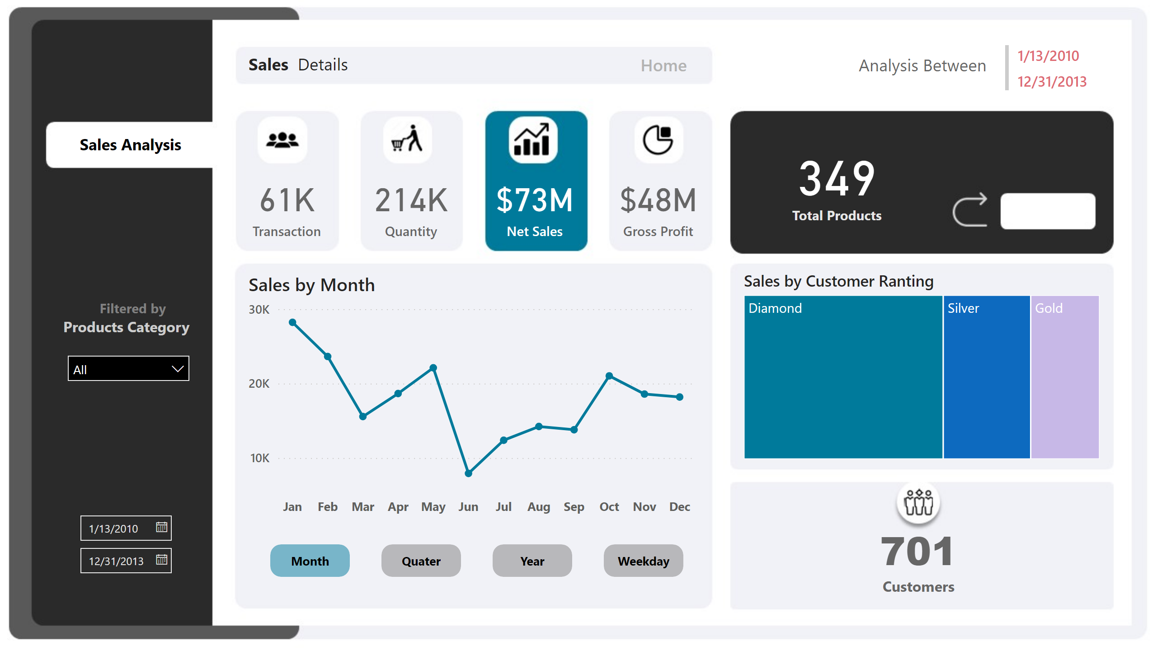
Net Sales Report
Notes:
InactiveQuater
No alt text provided
actionButton
No alt text provided
actionButton
No alt text provided
InactiveYear
No alt text provided
ActiveMonth
No alt text provided
actionButton
No alt text provided
actionButton
No alt text provided
InactiveWeekday
No alt text provided
transectionCard
No alt text provided
qauatityCard
No alt text provided
saleCard
No alt text provided
profitCard
No alt text provided
ProductCard
No alt text provided
Sales by Month
No alt text provided
columnChart
No alt text provided
columnChart
No alt text provided
columnChart
No alt text provided
Sales by Customer Ranting
No alt text provided
ProductCard
No alt text provided
actionButton
No alt text provided
textbox
No alt text provided
textbox
No alt text provided
multiRowCard
No alt text provided
slicer
No alt text provided
slicer
No alt text provided
textbox
No alt text provided
InactiveQuater
No alt text provided

Slide 7
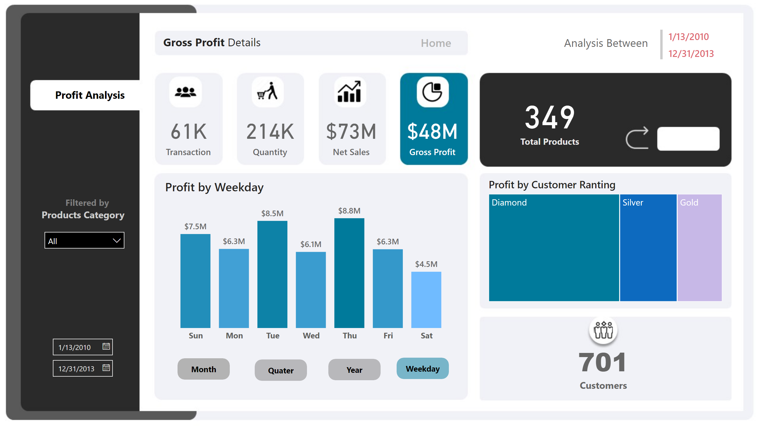
Profit Report
Notes:
InactiveQuater
No alt text provided
actionButton
No alt text provided
actionButton
No alt text provided
InactiveYear
No alt text provided
actionButton
No alt text provided
InactiveMonth
No alt text provided
ActiveWeekday
No alt text provided
actionButton
No alt text provided
transectionCard
No alt text provided
qauatityCard
No alt text provided
saleCard
No alt text provided
profitCard
No alt text provided
ProductCard
No alt text provided
lineChart
No alt text provided
columnChart
No alt text provided
columnChart
No alt text provided
Profit by Weekday
No alt text provided
Profit by Customer Ranting
No alt text provided
ProductCard
No alt text provided
actionButton
No alt text provided
textbox
No alt text provided
textbox
No alt text provided
multiRowCard
No alt text provided
slicer
No alt text provided
slicer
No alt text provided
textbox
No alt text provided
InactiveQuater
No alt text provided

Slide 8
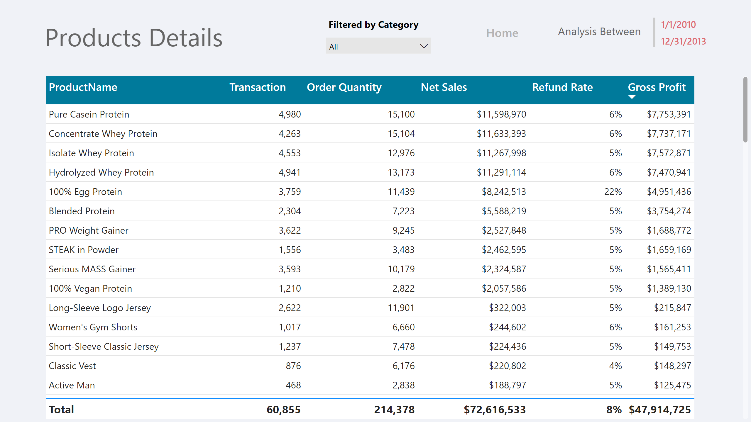
Product Detail Report
Notes:
tableEx
No alt text provided
textbox
No alt text provided
slicer
No alt text provided
textbox
No alt text provided
textbox
No alt text provided
multiRowCard
No alt text provided
actionButton
No alt text provided

